Slide 1
Making Alternatives to Guardianship a Reality in NC Wednesday, February 10, 2021 Linda Kendall Fields, M.Ed. UNC – Chapel Hill School of Social Work The Cares Program – Facilitating Systems Change With and For Adults of All Ages

Slide 2
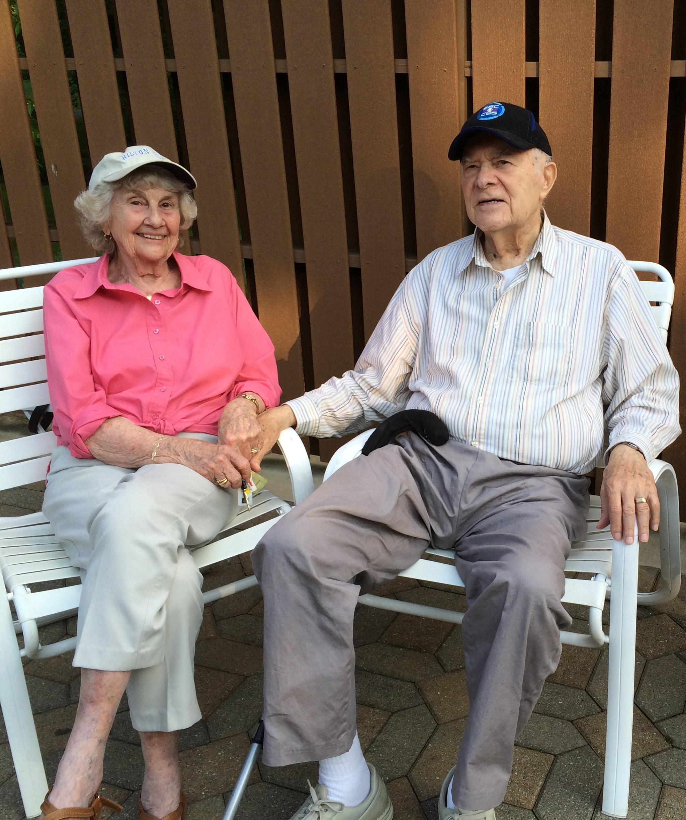
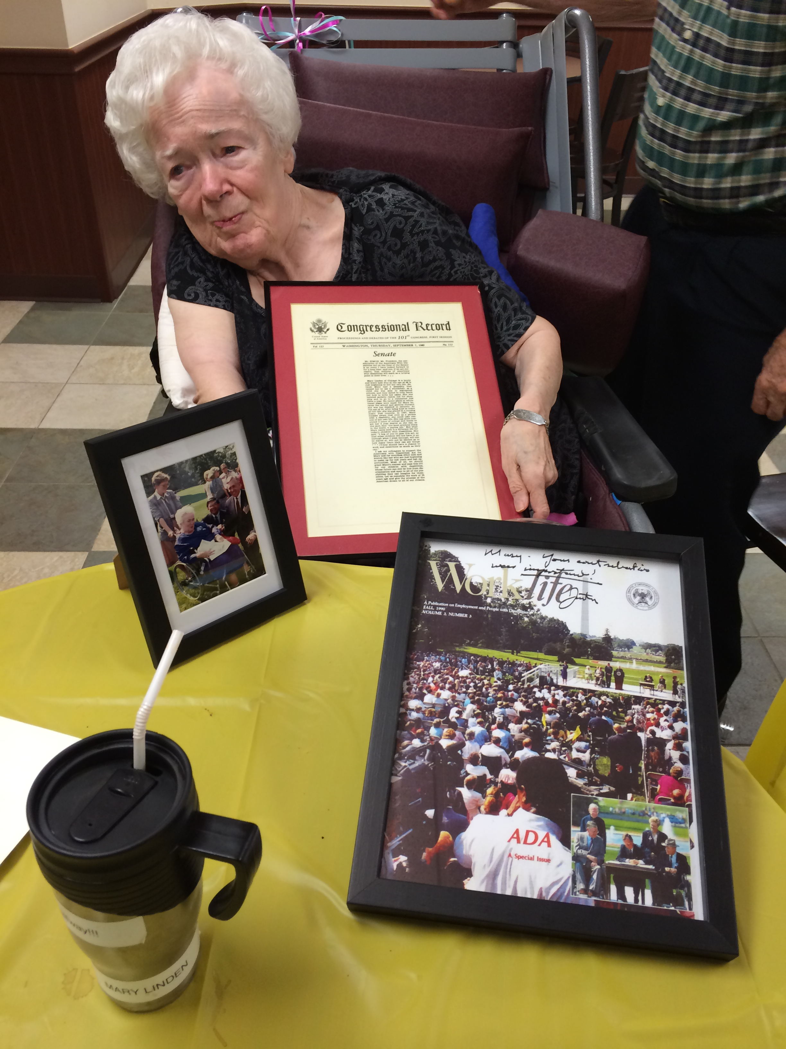
A Personal Introduction to This Work…

Slide 3
Today’s Objectives…
Build awareness of adult guardianship in NC and the NC Rethinking Guardianship initiative
Share resources about guardianship and less restrictive alternatives
Provide an update on significant activities in 2021
Invite participation in evolving family and societal systems change around decision-making

Slide 4
Background on Guardianship in NC
Guardianship removes an adult’s rights to manage his or her life decisions and places those decision-making responsibilities with a court appointed guardian.
It is estimated that there are more than 23,000 adults subject to guardianship in NC. Out of 5,000 adults in the state who were served by a public guardian in 2013, nearly 3,000 (56%) were adults ages 18-59 years old, the majority of whom (85%) had an intellectual/developmental disability and/or mental illness
Approximately one-third of individuals under guardianship have a public guardian; approximately two-thirds have private guardians, many of whom are family members.
Even now, due to the way that records are kept, it is not possible to know how many adults in North Carolina are currently under guardianship.

Slide 5
North Carolina
100 Counties – 100 Jurisdictions – 100 Clerks of Court

Slide 6
Types of Guardians
Guardian of the Person
has authority to make decisions in most areas of a adult’s personal life, exclusive of assets. This includes giving consent or approval for the adult subject to guardianship to receive any needed medical services (with some limitations such as sterilization, amputations and end of life).
Guardian of the Estate
has authority to manage the adult's assets such as bank accounts, brokerage accounts, vehicles, real estate, personal property, cash and income such as pensions, dividends, wages, interest and rental income.
General Guardian
has the powers and duties of both a guardian of the person and a guardian of the estate.
Interim Guardian
A limited duration version of any of the above, appointed by the Court due to an emergency. Its termination date (when the authority ends) will be shown on the face of the document.
Limited Guardianship
Tailored to fit the individual in the areas in which assistance with decision-making is needed

Slide 7
Who can be appointed as guardians?
N.C.G.S. § 35A-1214
The clerk shall consider appointing a guardian according to the following order of priority:
An individual recommended in a written instrument (such as a Will, Power of Attorney, etc);
an individual;
a corporation or a disinterested public agent.
No public agent shall be appointed guardian until diligent efforts have been made to find an appropriate individual or corporation to serve as guardian
In every instance the clerk shall base the appointment of a guardian or guardians on the best interest of the ward.

Slide 8
Rethinking Guardianship is …
Creating long-term changes in the state’s guardianship system
Promoting less restrictive alternatives to guardianship

Slide 9
Our History- Our Present – Our Future
Rethinking Guardianship: Building a Case for Less Restrictive Alternatives –
January 2015 - December 2017
Rethinking Guardianship: A Person-Centered Approach
July 2018 – December 2019
Rethinking Guardianship Bridge Initiative
January 2020 – June 2020
Making Alternatives to Guardianship a Reality in NC
July 2020 – June 2023
Collective Impact framework:
Backbone, Common Agenda, Shared Measurement, Continuous Communication, Mutually Reinforcing Activities
Statewide workgroup with diverse affiliations and Steering Team
National WINGS (Working Interdisciplinary Network of Guardianship Stakeholders)
Notes:
~Common agenda
~Continuous communication
~Shared measurement
~Backbone support
~Mutually reinforcing activities

Slide 10
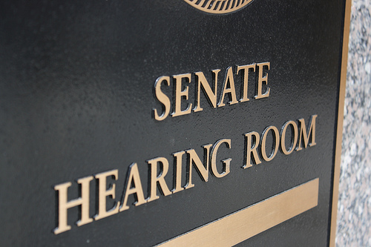
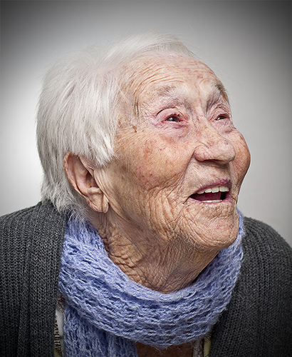
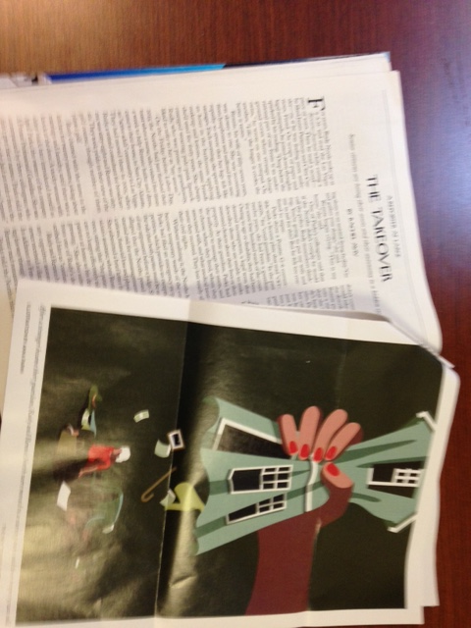
It’s About Ensuring Rights and Protecting Elders…
This Photo by Unknown Author is licensed under CC BY-SA

Slide 11
It’s Also About Adults with Disabilities of All Ages…
Jenny Hatch –”I don’t need a guardian. I just need a little help”

Slide 12
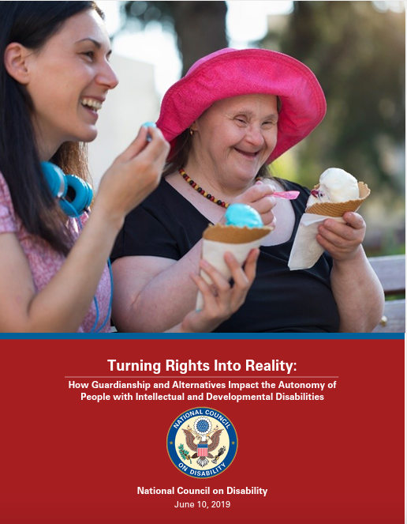
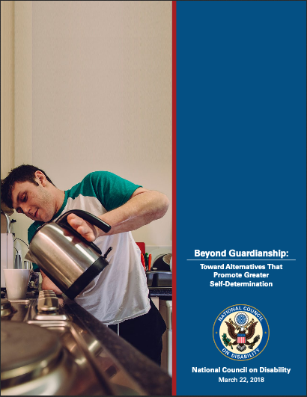
National Council on Disability 2018 & 2019 Reports
Add previous report

Slide 13
Common Agenda
Core concepts and basic principles:
Autonomy, liberty, freedom, dignity
Presumption of competence
Right to life-time decision-making support

Slide 14
Common Agenda/Shared Aspiration
The System-as-it-Should-be would
Always use least restrictive options and be based on best practices
Offer easily available and accessible information about options and alternatives to guardianship that is communicated to and understood by stakeholders
Rest on a process in which all stakeholders are identified and engaged
Have built-in accountability for all stages of guardianship and less restrictive alternatives.

Slide 15
The Importance of a Balanced Approach
Autonomy - Support - Protection

Slide 16
How Many People Declared Incompetent in NC? July 1, 2012 – December 31, 2015
Notes:
Side – Legal terms are ward and incompetent. I try to avoid the term ward, please forgive me if I slip up. Use incompetent when referring to the ruling.

Slide 17
How Many People Sought & Received Restoration?
Notes:
15,798 people in dataset
468 (3.0%) had some restoration activity
326 (69.7%) of those with activity received restoration
This is only 2.1% of people with guardianship court action in those years
Only 57 (12.2%) people had a denial at the end of the record

Slide 18
Catawba Data Analysis January 1, 2015 – September 30, 2016

Slide 19
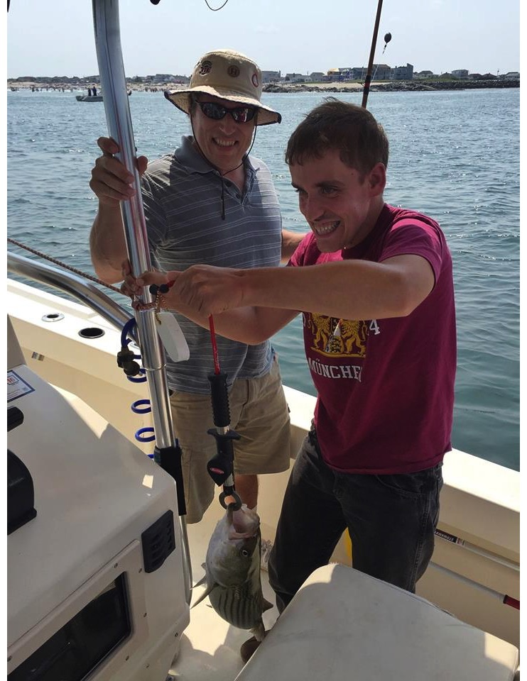
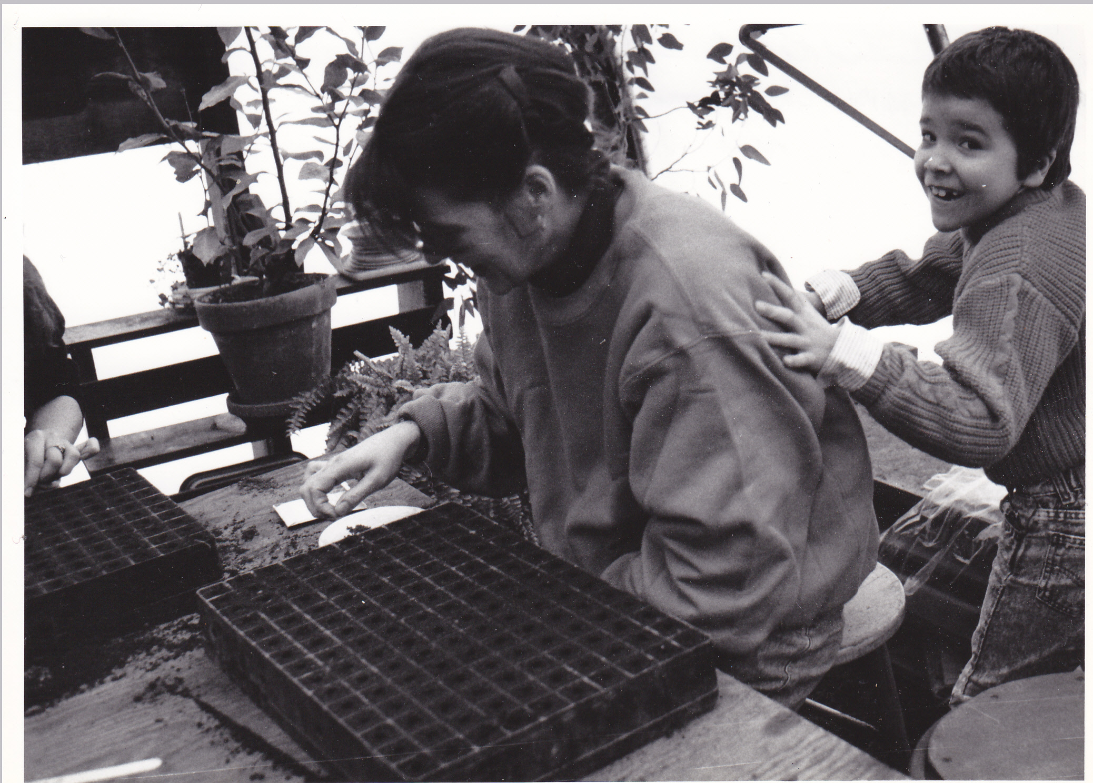
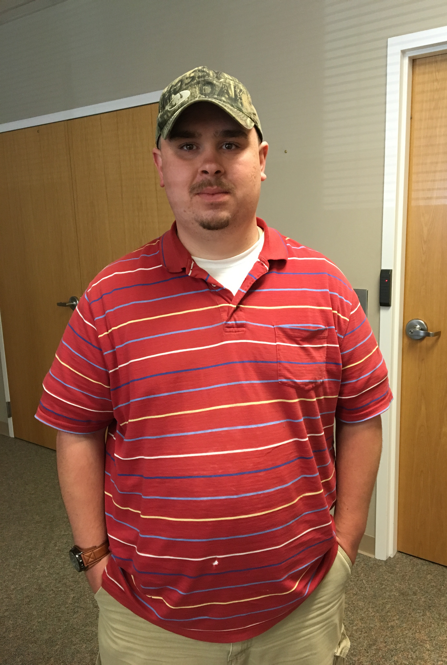
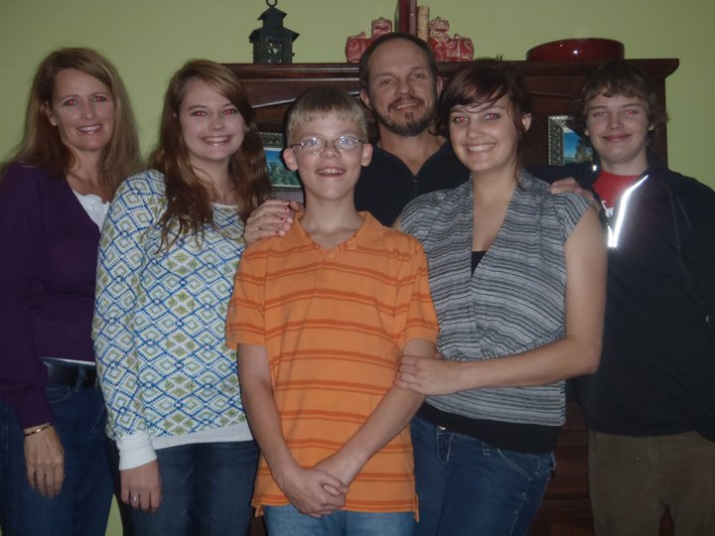

Slide 20
Story Themes
Desire to do what is best for one’s family member
Expressions of individuals’ hope and desire for autonomy and choice
Surprise or shock about what was unknown before, during, and after guardianship – Legally binding, may not offer the desired results
Disillusionment over the role of the guardian ad litem because of a seeming “disconnect” between what is expected of that person and what is experienced
Feelings of outrage or despair when perceived that the court appointed guardian took control of an adult’s life and abused this power
Empowerment and pride at the prospect (and realization) of restoration.

Slide 21
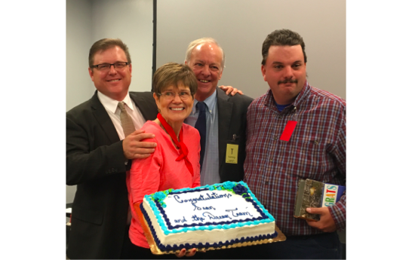
Sean’s Story

Slide 22
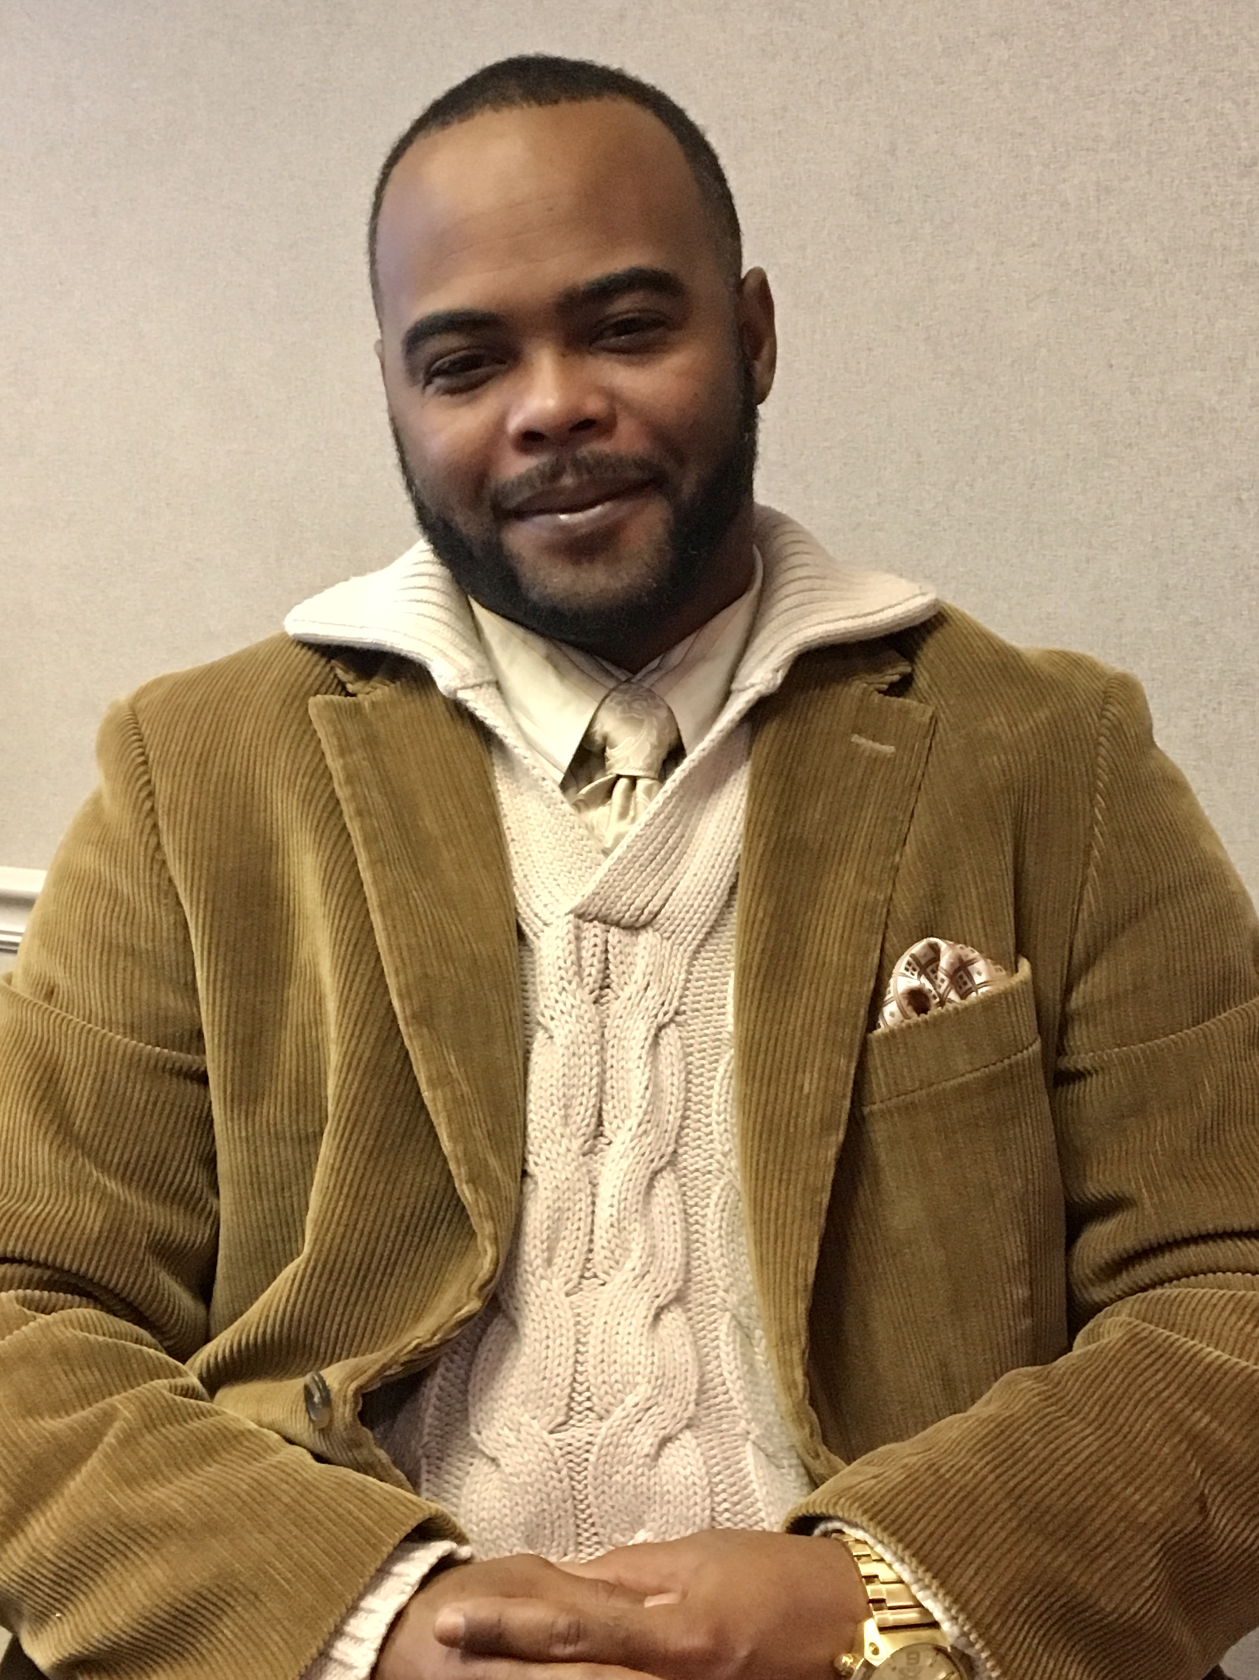
Jason’s Story
“I do it completely on my own now. Once in awhile, I ask my mother for her opinion, but I’m an adult. I make my own decisions…I value the opportunity to help others and appreciate the path that led me to… mental wellness.”

Slide 23
Making Alternatives to Guardianship a Reality in North Carolina
Recommended by Rethinking Guardianship - NCCDD Funded for July 2020 – June 2023
Focused on Youth Transitioning to Adulthood and Adults Transitioning to the Community from Long Term Residential Facilities
“If you want fewer guardianships, stay out of the courtroom”

Slide 24
2021 Areas of Focus
Reforms to GS 35A in preparation for the 2023 long session
Addressing the school to guardianship “pipeline”
Participating in the Olmstead planning process
Creating accessible, on demand educational modules on Supported Decision-Making strategies

Slide 25
NC General Statute 35A Reform
change language (e.g. adult subject to guardianship)
requirement for consideration of alternatives to guardianship
process for regular review (rather than presumption of permanence) with possibility of increased use of limited guardianship and restoration
rights for those under guardianship
provide for appointed counsel in addition to GAL

Slide 26
School-to-Guardianship Pipeline
“For a variety of reasons, youth with
I/DD are disempowered by schools actively encouraging guardianship to the exclusion of less restrictive alternatives and not providing families and students with sufficient information about the availability of a full continuum of decision-making supports.” NCD 2019 report

Slide 27
A quick recent example in NC
NC Local Education Agency (school district) Message to NC Department of Public Instruction, Exceptional Children’s Division to review transfer of rights brochure…
As it arrived:
“The guardianship/conservatorship process
should begin… If families and students feel uncomfortable
with the transfer of the decision-making
abilities of the student, the prospective
guardian needs to petition for guardianship
at the local probate court.”

Slide 28
Suggested Change… Interrupting the “Pipeline to Guardianship”
“If families and students feel uncomfortable with the transfer of decision-making authority to the student, there are many strategies and opportunities to support the student’s transition into adulthood.”
“Parents and students can learn about free or low cost options by visiting https://rethinkingguardianshipnc.org/ and the National Resource Center for Supported Decision-Making at http://supporteddecisionmaking.org
As a last resort, parents may petition for limited or full guardianship at the local probate court.”

Slide 29
Supported Decision-Making
“a recognized alternative to guardianship through which people with disabilities use friends, family members, and professionals to help them understand the situations and choices they face, so they may make their own decisions without the ‘need’ for a guardian.” - Blanck & Martinis, 2015

Slide 30
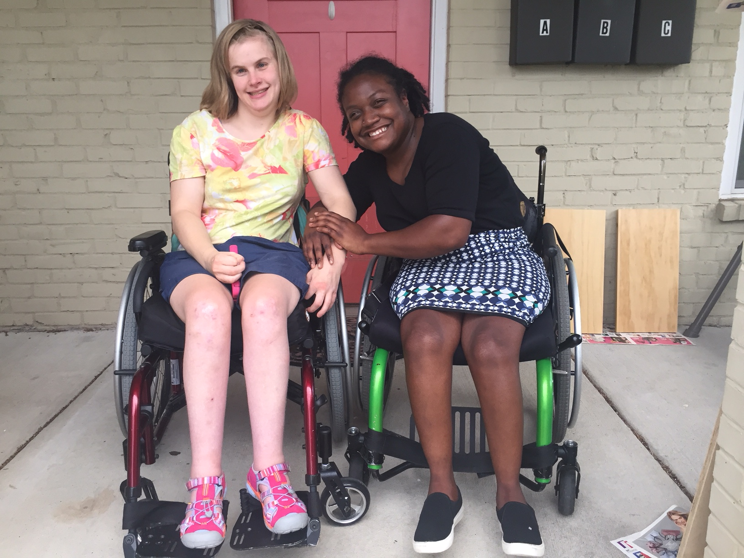
“Living on their own for two years together, Suvya & Janie have figured out who can help most effectively with what. It is incumbent on people supporting these women to push them to make their own decisions when it is clearly in their power. This does not mean they will always get it right, but without stretching the muscles, there is no growth. This has clearly led to less asking, more acting, and greater self-determination.”
*Shared by Janie’s mother Betsy MacMichael, Executive Director, First in Families of NC

Slide 32
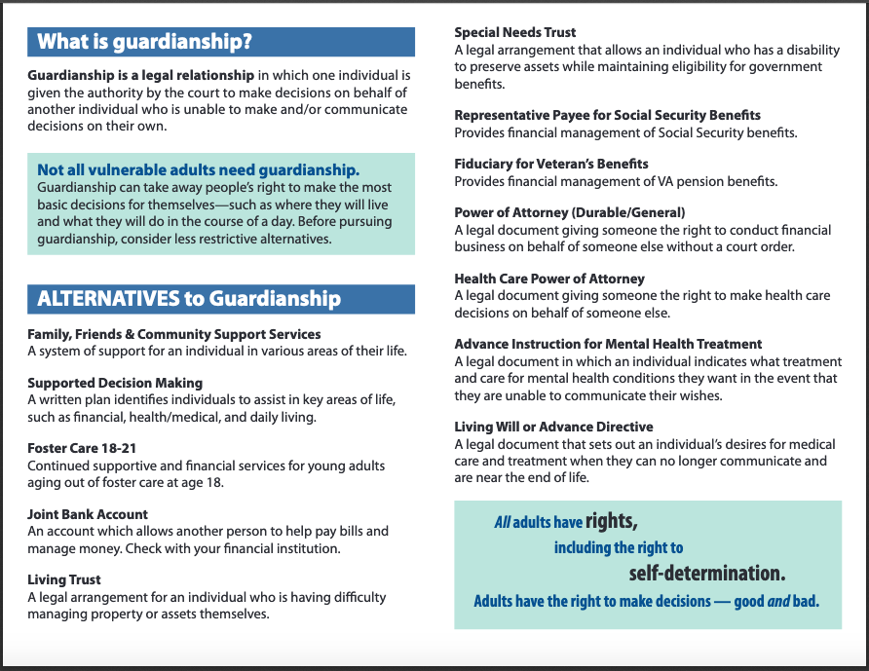

Slide 33
Supported Decision-Making in North Carolina: Understand Your Options – SAMPLE LANDING PAGE
Start Here: Supported Decision-Making 101
Once you understand the basics, click on the options below to learn more about your options.
Family, Friends and Community Support Services
Supported Decision-Making Agreement
Foster Care 18-21
Joint Bank Account
ABLE Account
Living Trust
Special Needs Trust
Representative Payee for Social Security Benefits
Fiduciary for Veteran’s Benefits
Power of Attorney (Durable/General)
Health Care Power of Attorney
Advance Instruction for Mental Health Treatment
Living Will or Advance Directive

Slide 35
More information?
Visit the Rethinking Guardianship website
https://rethinkingguardianshipnc.org/
Join the Rethinking Guardianship Workgroup! Email me at lkfields@email.unc.edu

Slide 36
Resources
North Carolina Rethinking Guardianship Website
rethinkingguardianshipnc.org/
National Council on Disability (NCD) - Beyond Guardianship: Toward Alternatives That Promote Greater Self-Determination for People with Disabilities - https://ncd.gov/publications/2018/beyond-guardianship-toward-alternatives
National Council on Disability – Turning Rights Into Reality
https://ncd.gov/publications/2019/turning-rights-into-reality
National Resource Center for Supported Decision-Making
http://supporteddecisionmaking.org/
MO Guardianship: Understanding Your Options and Alternatives
http://moguardianship.com/#materials
The Jenny Hatch Justice Project
http://jennyhatchjusticeproject.org/home

Slide 37
Linda Kendall Fields M.Ed.
Clinical Assistant Professor
UNC Chapel Hill School of Social Work
(828) 712-4003
lkfields@email.unc.edu

